Slide 1

Visualizing Real-Time Strategy Games: The Example of StarCraft II
Authors:Yen-Ting Kuan, Yu-Shuen Wang, Jung-Hong Chuang
PRESENTED BY: LALITHABHINAYA MALLU

Slide 2
Real-time strategy(RTS) is a subgenre of strategy video games where the game does not progress incrementally in turns.

Slide 3
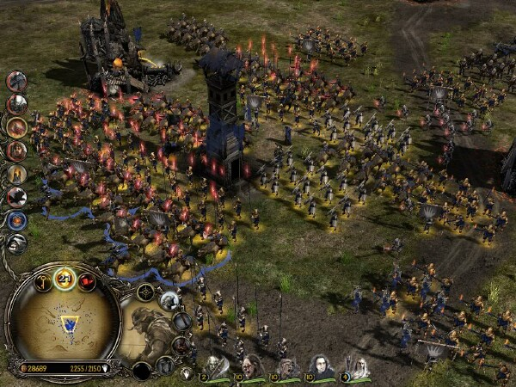
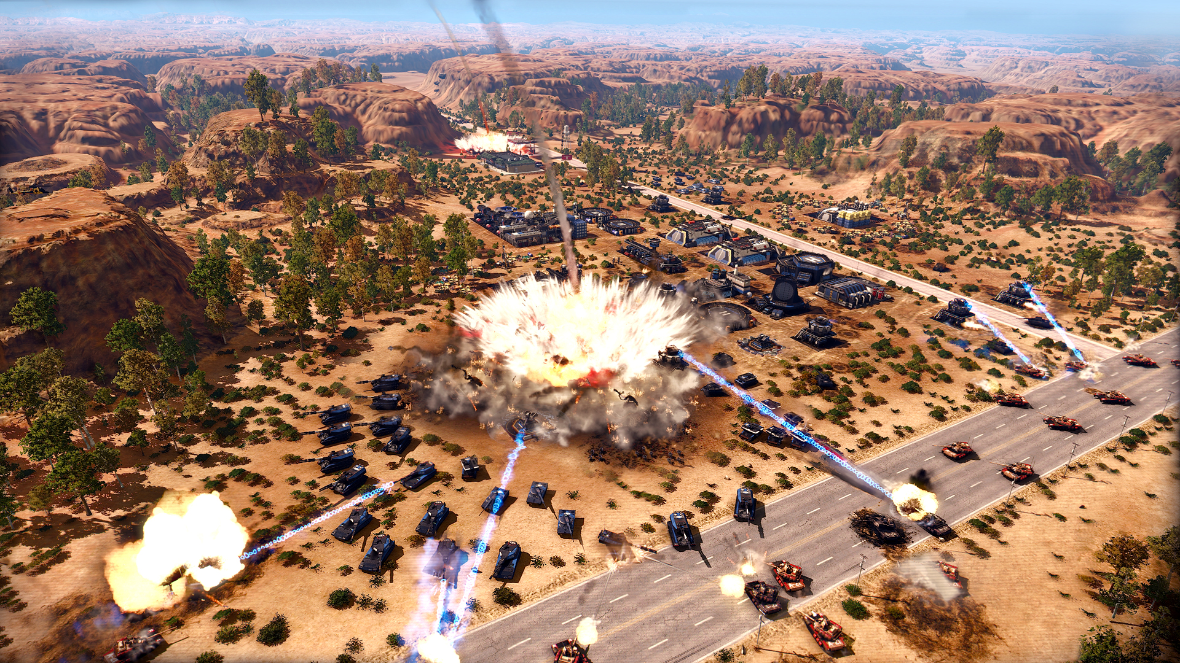

Slide 4

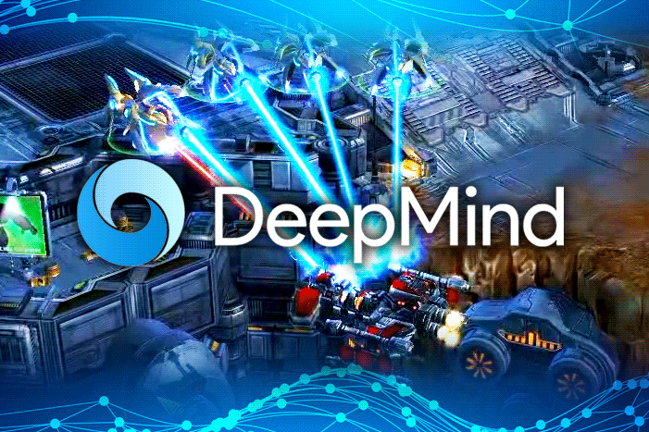

Slide 5
Goal:
The goal is to help humans quickly understand an RTS game, and how and why a nation was defeated.

Slide 6
Previous Works
Data analysis and visualization for RTS Games
Depict statistics of SC2 games by line charts
Scelight [Belicza 2013]
GGTracker [Joerg 2012]

Slide 7
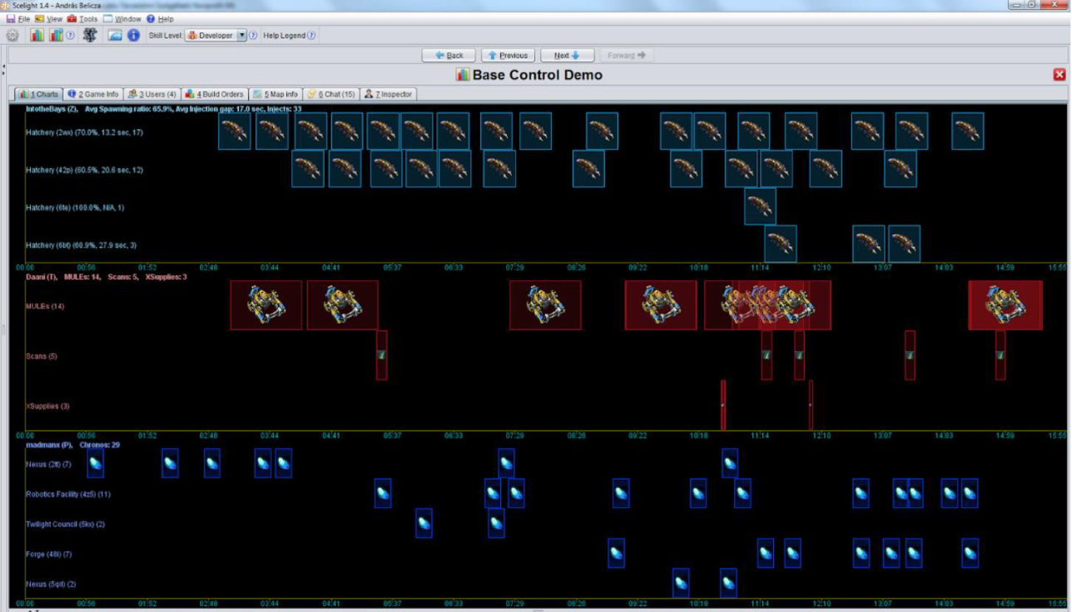
Scelight[Belicza 2013]

Slide 8
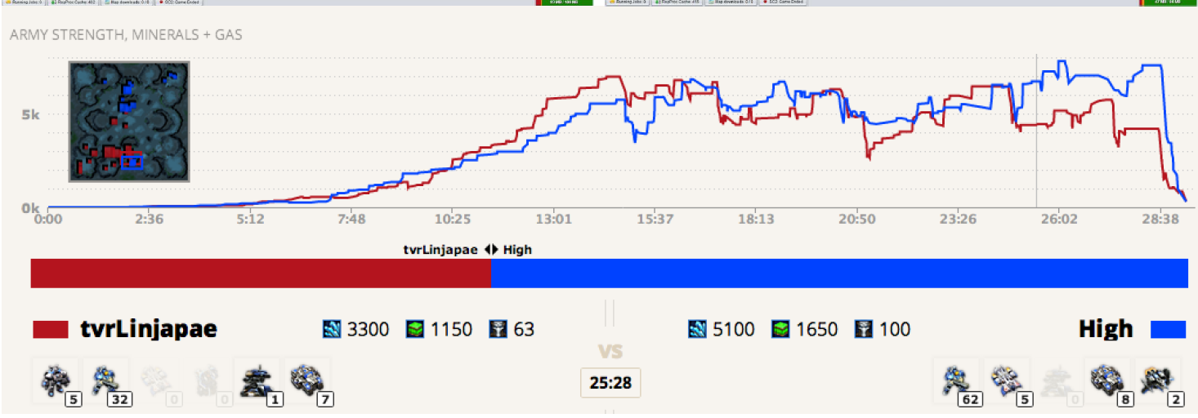
GGTracker[Joerg 2012]

Slide 9
How to play StarCraft II (SC2) game?
Build nation based on the selected race and establish the military to eliminate the opponent.
Steps:
Command workers
Construct Buildings
Formations

Slide 10
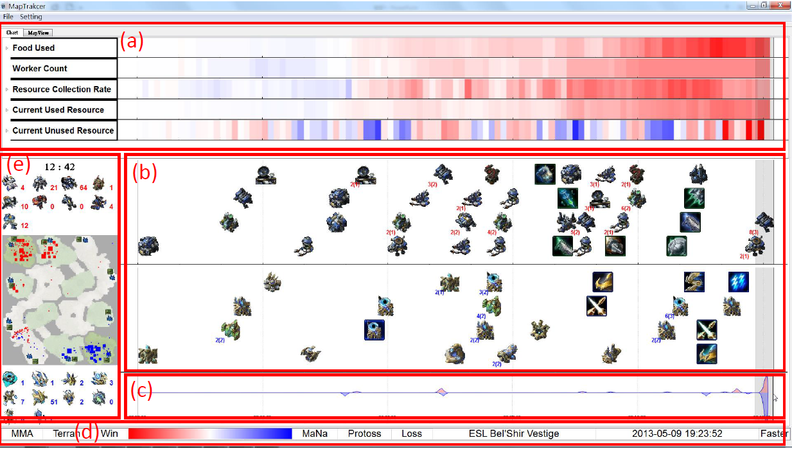
Visualization Interfaces –Status View
Color-coded charts
Build order
Context map
Death theme river

Slide 11
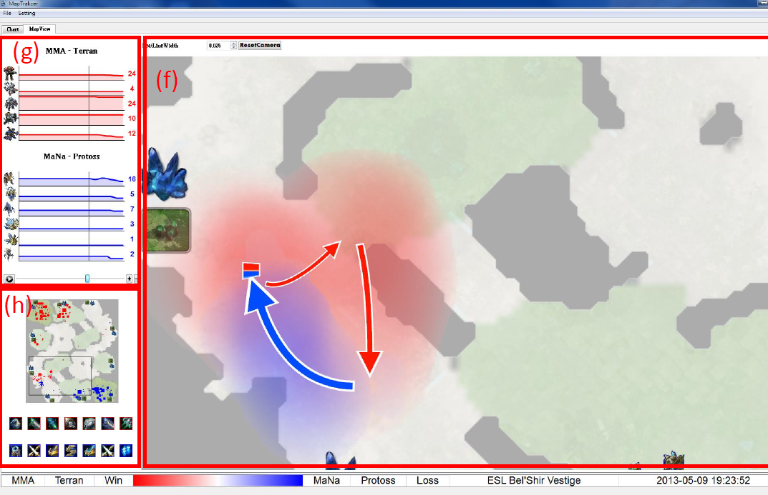
Visualization Interfaces –Battle view
Strengths of units
Height Map
Context map
Status bar

Slide 12
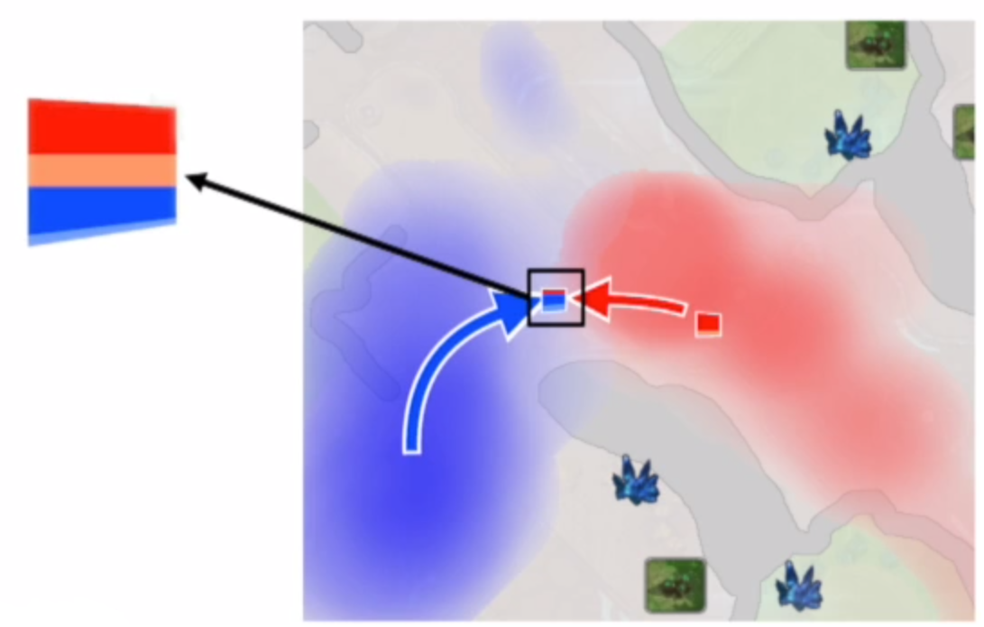
Hierarchical Battle visualization
Battle Glyph

Slide 13
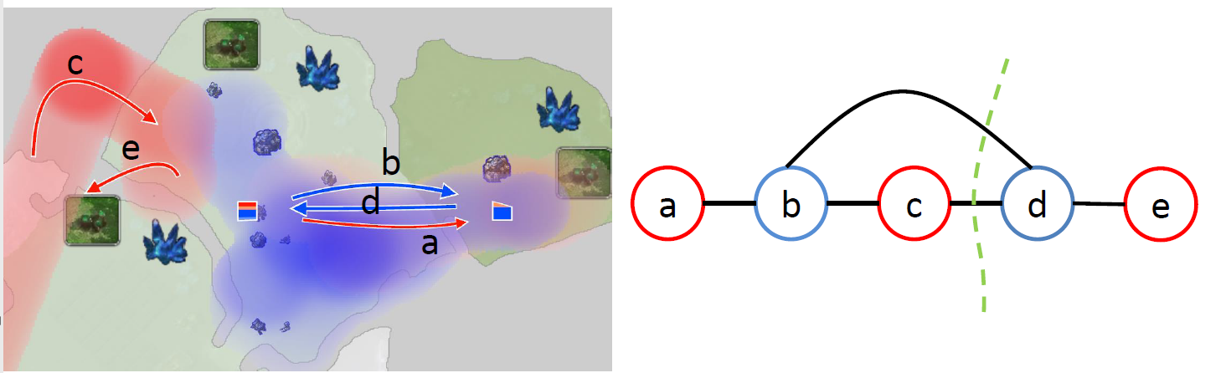
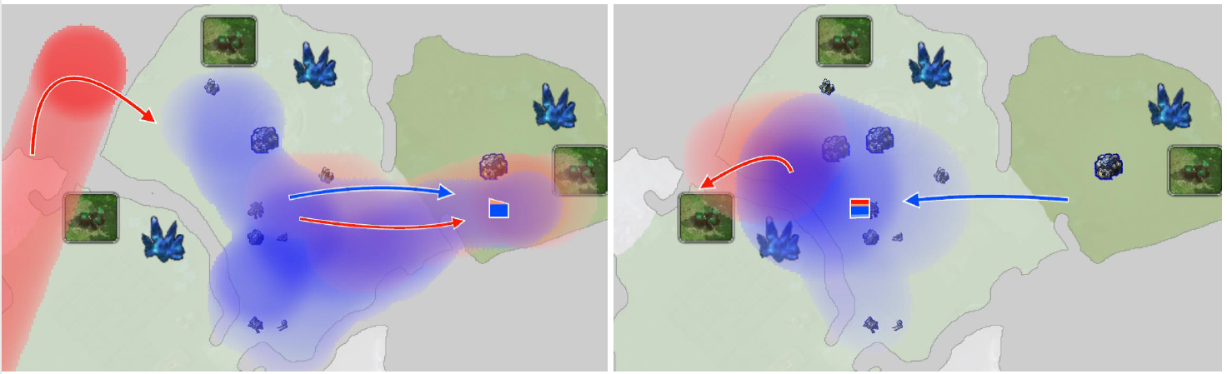
Global View of Battle
Cyclic curved arrows would cause ambiguity.
They should be drawn in steps.

Slide 14
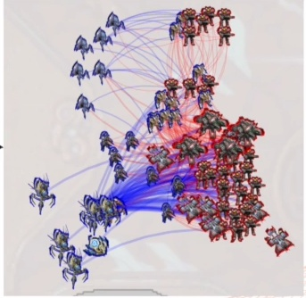
Local View of Battle
Every unit on the map is visualized by a small image and its motion is represented by an animation.

Slide 15
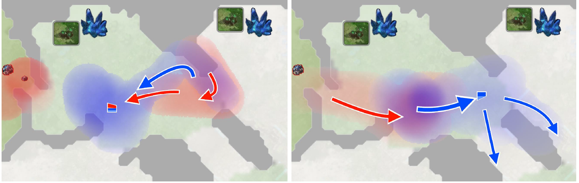
Case 1: Surround-Failure example

Slide 16
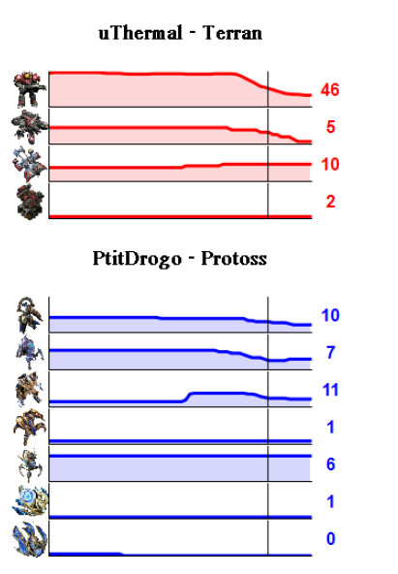
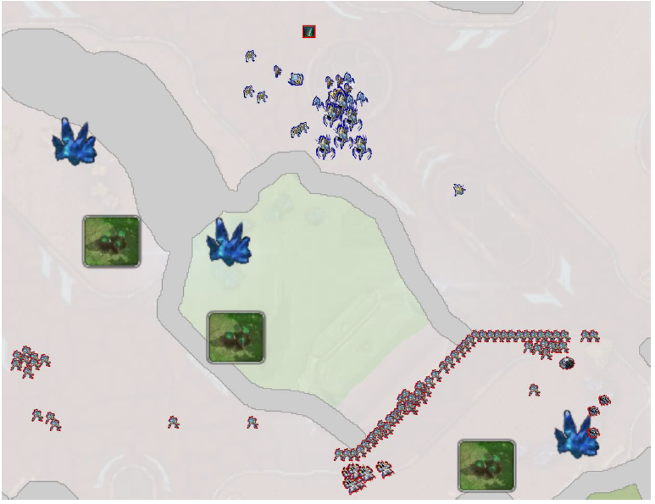
Case 2: Formation and configuration

Slide 17
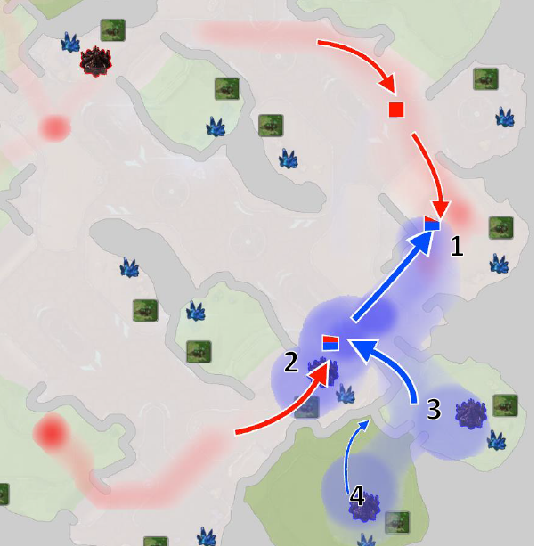
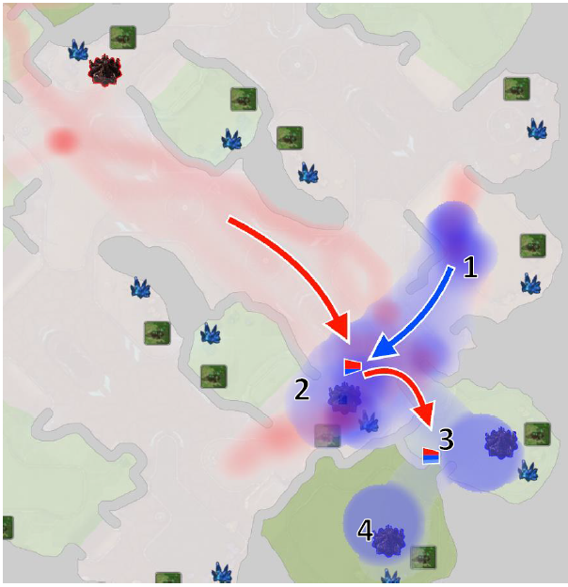
Case 3: Tactics

Slide 18
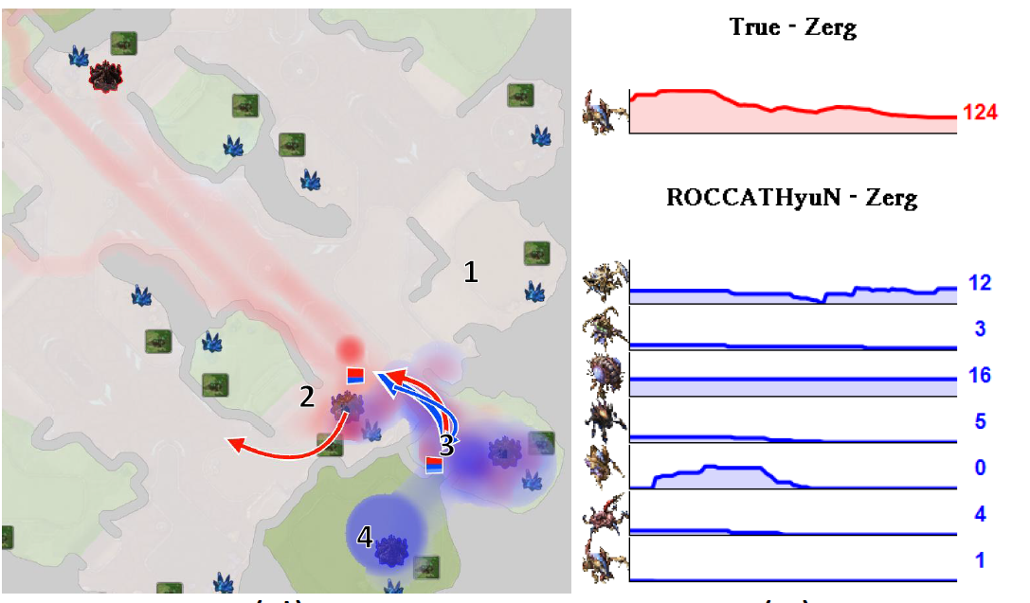
Case 3: Tactics

Slide 19
User Study
20 participants
Game ages ranged from 0.5 to 7 years.
Covered levels: Master(top 4%), diamond(4-23%),platinum(23-46%),gold(78-96%) and bronze(96-100%).
Our system(OO)
Scelight + GGTracker +official replay(SGO)

Slide 20
User study Procedure
Received a tutorial to learn interfaces of Scelight, GGtracker and our system.
Examine four game replays with the assistance of SGO and OO
Easy: g1,g2
Medium: g3
Difficult : g4
Answer why a nation beat the other in each game

Slide 21
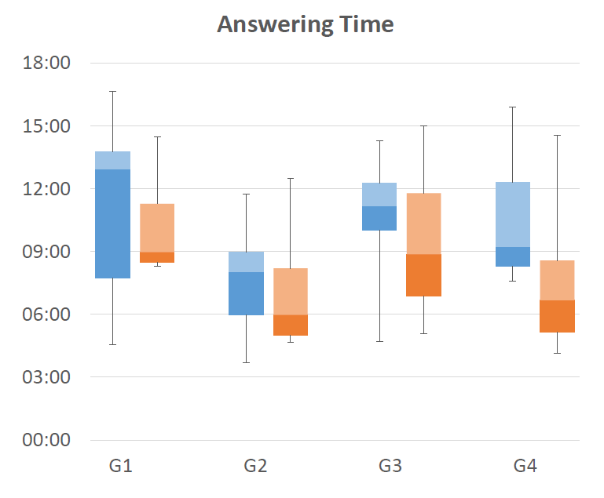
User Study-Quantitative results
SGO
OO

Slide 22
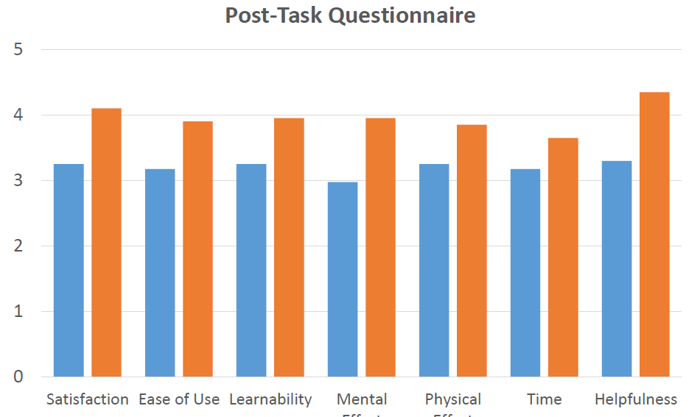
User Study-Quantitative results
SGO
OO

Slide 23
Conclusion and Future work
A visualization system for users to study SC2 games.
Users can learn strategies from previous game data.
Has the potential to visualize other RTS games.
Improve visual quality
Visualize multiple games simultaneously.

Slide 24


